Slide 1
Use Cases and Scenarios

Slide 2
We Will Cover
What is a use-case
  Use-case versus user interaction
Use-Case diagrams
  The constructs in the use-case diagrams
Capturing the use-case
  High-level use-case
  Extended use-case
  Difference between use case and scenario

Slide 3
What is a Use-Case
A use-case captures some user visible function
This may be a large or small function
  Depends on the level of detail in your modeling effort
A use-case achieves a discrete goal for the user
Examples
  Format a document
  Request an elevator
How are the use cases found (captured or elicited)?

Slide 4
User Goals versus User Interactions
Consider the following when formatting a document
    Define a style
    Change a style
    Copy a style from one document to the next
  versus
    Format a document
    Ensure consistent formatting of two documents
The latter is a user goal
  Something the user wants to achieve
The former are user interactions
  Things the user does to the system to achieve the goal

Slide 5
Goals and Interactions
There is a place for both goals and interactions
Understand what the system shall do
  Capture the user goals
Understand how the user will achieve the goals
  Capture user interactions
  Sequences of user interactions
Thus, start with the user goals and then refine the user goals into several (many) user interactions

Slide 6
Use-Case Diagrams (POST)
POST: Point of Sale Terminal
Use Case
POST
System Boundary
Buy Item
Log In
Cashier
Customer
Refund a Purchased Item
Adapted from Larman “Applying UML and Patterns”

Slide 7
Another Example
Financial Trading System
Set Limits
Update Accounts
Accounting System
Trading Manager
Analyze Risk
«includes»
Valuation
«includes»
Price Deal
Trader
Capture Deal
«extends»
Salesperson
Adapted from Fowler “UML Distilled”
Limit Exceeded

Slide 8
Includes and Extends
Includes
  You have a piece of behavior that is similar across many use cases
  Break this out as a separate use-case and let the other ones “include” it
  Examples include
    Valuation
    Validate user interaction
    Sanity check on sensor inputs
    Check for proper authorization
Extends
  A use-case is similar to another one but does a little bit more
  Put the normal behavior in one use-case and the exceptional behavior somewhere else
    Capture the normal behavior
    Try to figure out what can go wrong in each step
    Capture the exceptional cases in separate use-cases
  Makes it a lot easier to understand

Slide 9
Includes
You have a piece of behavior that is similar across many use cases
Break this out as a separate use-case and let the other ones “include” it
Examples include
  Valuation
  Validate user interaction
  Sanity check on sensor inputs
  Check for proper authorization

Slide 10
Extends
A use-case is similar to another one but does a little bit more
Put the normal behavior in one use-case and the exceptional behavior somewhere else
  Capture the normal behavior
  Try to figure out what can go wrong in each step
  Capture the exceptional cases in separate use-cases
Makes it a lot easier to understand

Slide 11
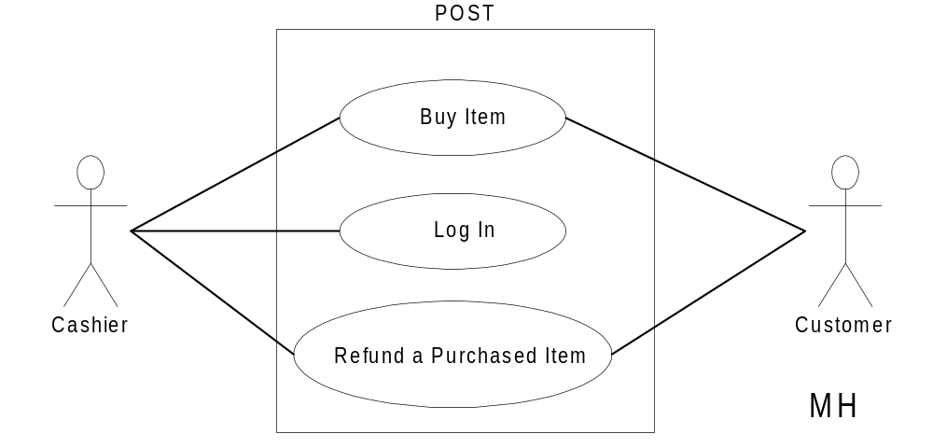
Setting the System Boundary
The system boundary will affect your actors and use-cases
Adapted from Larman “Applying UML and Patterns”

Slide 12
A Different Boundary
Let us view the whole store as our system
Store
Buy Item
Refund a Purchased Item
Customer
Adapted from Larman “Applying UML and Patterns”

Slide 13
Embedded System
“Onion Skin”
*
Perception/Action
Sensors/Actuators
Interfaces
System

Slide 14
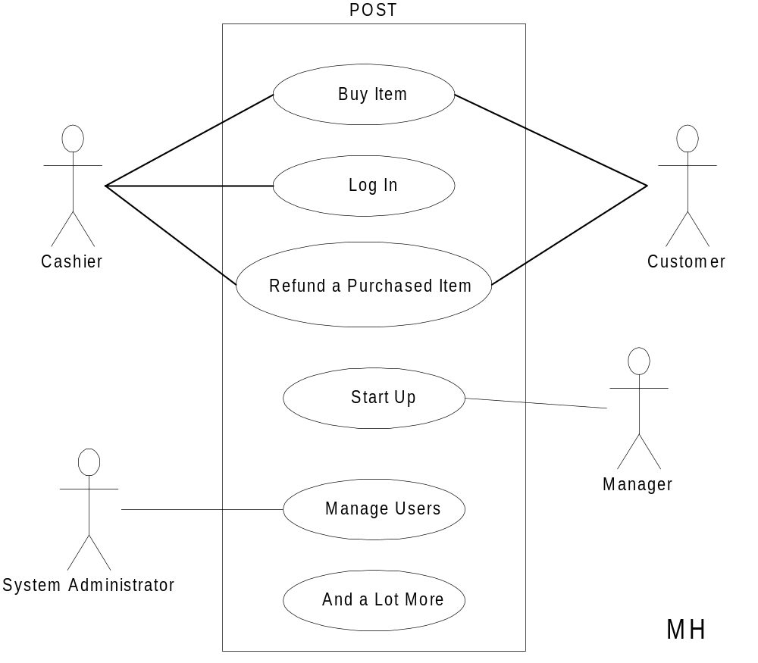
Partial POST
Adapted from Larman “Applying UML and Patterns”

Slide 15
POST Use-Case
Use case: Buy Item
Actors: Customer (initiator), Cashier
Type: Primary
Description: The Customer arrives at the
checkout with items to purchase.
The Cashier records the purchase
items and collects a payment.
On completion the Customer
leaves with the items

Slide 16
POST Expanded Use-Case
Use case: Buy Item
Actors: Customer (initiator), Cashier
Type: Primary and essential
Description: The Customer arrives at the checkout with items
to purchase. The Cashier records the purchase
items and collects a payment. On completion the
Customer leaves with the items.
Cross Ref.: Requirements XX, YY, and ZZ
Use-Cases: Cashier must have completed the Log In use-case

Slide 17
Typical Course of Events
Actor Action
This use-case begins when a user arrives at the checkout
The cashier records purchase items
The cashier collects payment
The user leaves with items

Slide 18
The Home Heating System
*
Temp Sensor
Water Pump
Water Valve
Hot Water
Home
Controller
Burner
Fuel Valve
90
80
70
60
50
Off
On
Fuel
Control Panel
Temp Sensor

Slide 19
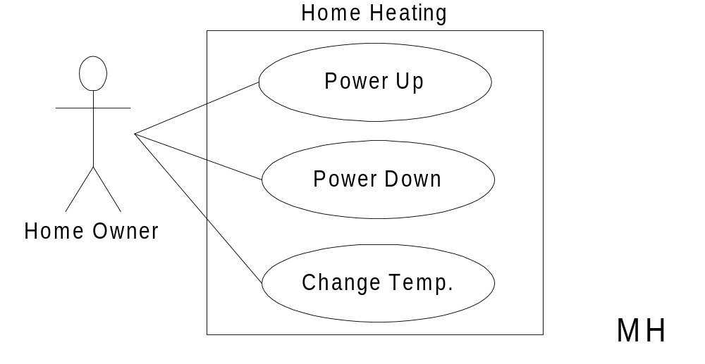
Home Heating Use-Case Diagram

Slide 20
Home Heating Use-Cases
Use case: Power Up
Actors: Home Owner (initiator)
Type: Primary and essential
Description: The Home Owner turns the power on. Each room
is temperature checked. If a room is below the
the desired temperature the valve for the room is
opened, the water pump started. If the water temp falls below threshold, the fuel valve is
opened, and the burner ignited.
If the temperature in all rooms is above the desired
temperature, no actions are taken.
Cross Ref.: Requirements XX, YY, and ZZ
Use-Cases: None

Slide 21
Modified Home Heating
Home Heating
Power Up
Temp. High
«includes»
«includes»
Power Down
Adjust Temp
Home Owner
«includes»
«includes»
Change Temp.
Temp. Low
MH

Slide 22
Modified:
Home Heating Use-Cases
*
Use case: Power Up
Actors: Home Owner (initiator)
Type: Primary and essential
Description: The Home Owner turns the power on.
Perform Adjust Temp. If the temperature
in all rooms is
above the desired temperature, no actions are taken.
Cross Ref.: Requirements XX, YY, and ZZ
Use-Cases: Perform Adjust Temp

Slide 23
Modified:
Home Heating Use-Cases
*
Use case: Adjust Temp
Actors: System (initiator)
Type: Secondary and essential
Description: Check the temperature in each room. For each room:
Below target: Perform Temp Low
Above target: Perform Temp High
Cross Ref.: Requirements XX, YY, and ZZ
Use-Cases: Temp Low, Temp High

Slide 24
Modified:
Home Heating Use-Cases
*
Use case: Temp Low
Actors: System (initiator)
Type: Secondary and essential
Description: Open room valve, start pump if not started.
If water temp falls below threshold,
open fuel value and ignite burner.
Cross Ref.: Requirements XX, YY, and ZZ
Use-Cases: None

Slide 25
Scenarios -- One Use Case
Power-up
All temps OK
Power-up
All temps too low
Open valves
Ignite burner
Open fuel valve
Start pump

Slide 26
Scenarios -- One Use Case
Power-up
All temps too low
Open valves
Ignite burner
Open fuel valve
Start pump
Burner fails
Shut off fuel
Stop pump
Notify error

Slide 27
HACS
Homework assignment and collection are an integral part of any educational system. Today, this task is performed manually. What we want the homework assignment distribution and collection system (HACS for short) to do is to automate this process.
HACS will be used by the instructor to distribute the homework assignments, review the students’ solutions, distribute suggested solution, and distribute student grades on each assignment.
HACS shall also help the students by automatically distributing the assignments to the students, provide a facility where the students can submit their solutions, remind the students when an assignment is almost due, remind the students when an assignment is overdue.

Slide 28
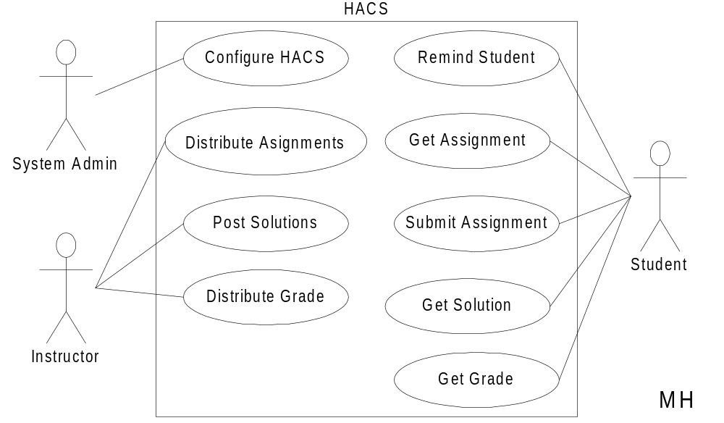
HACS Use-Case Diagram

Slide 29
HACS Use-Cases
Use case: Distribute Assignments
Actors: Instructor (initiator)
Type: Primary and essential
Description: The Instructor completes an assignment and submits
it to the system. The instructor will also submit the
due date and the class the assignment is assigned for.
Cross Ref.: Requirements XX, YY, and ZZ
Use-Cases: Configure HACS must be done before any user
(Instructor or Student) can use HACS

Slide 30
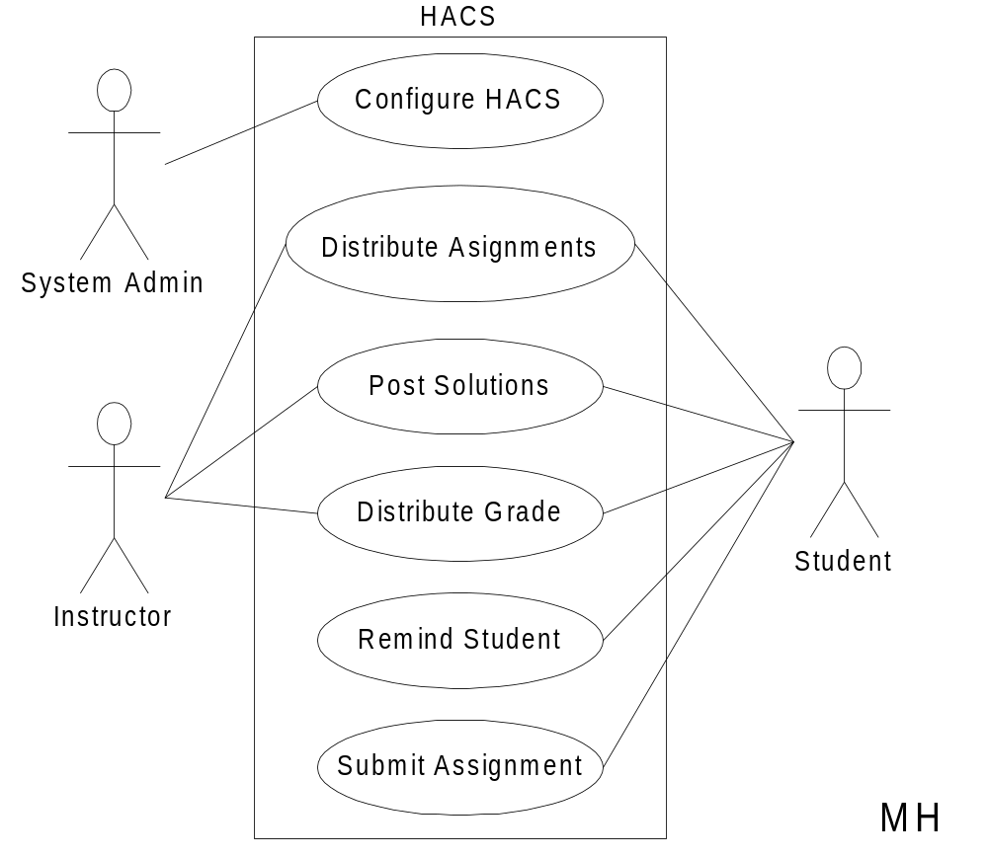
Alternate HACS

Slide 31
Alternate HACS Use-Cases
Use case: Distribute Assignments
Actors: Instructor (initiator), Student
Type: Primary and essential
Description: The Instructor completes an assignment and submits
it to the system. The instructor will also submit the
delivery date, due date, and the class the assignment
is assigned for. The system will at the due date mail
the assignment to the student.
Cross Ref.: Requirements XX, YY, and ZZ
Use-Cases: Configure HACS must be done before any user
(Instructor or Student) can use HACS

Slide 32
When to use Use-Cases
In short, always!!!
Requirements is the toughest part of software development
  Use-Cases is a powerful tool to understand
    Who your users are (including interacting systems)
    What functions the system shall provide
    How these functions work at a high level
Spend adequate time on requirements and in the elaboration phase

Slide 33
How it Fits Together
Preliminary Investigation Report
Requirements Specification
Use-Cases
a. All High Level
b. Some Expanded
Prototypes
Use-Case Diagram
Budget, Schedule
Draft Conceptual Model
Adapted from Larman “Applying UML and Patterns”
Glossary (data dictionary)

